Slide 1
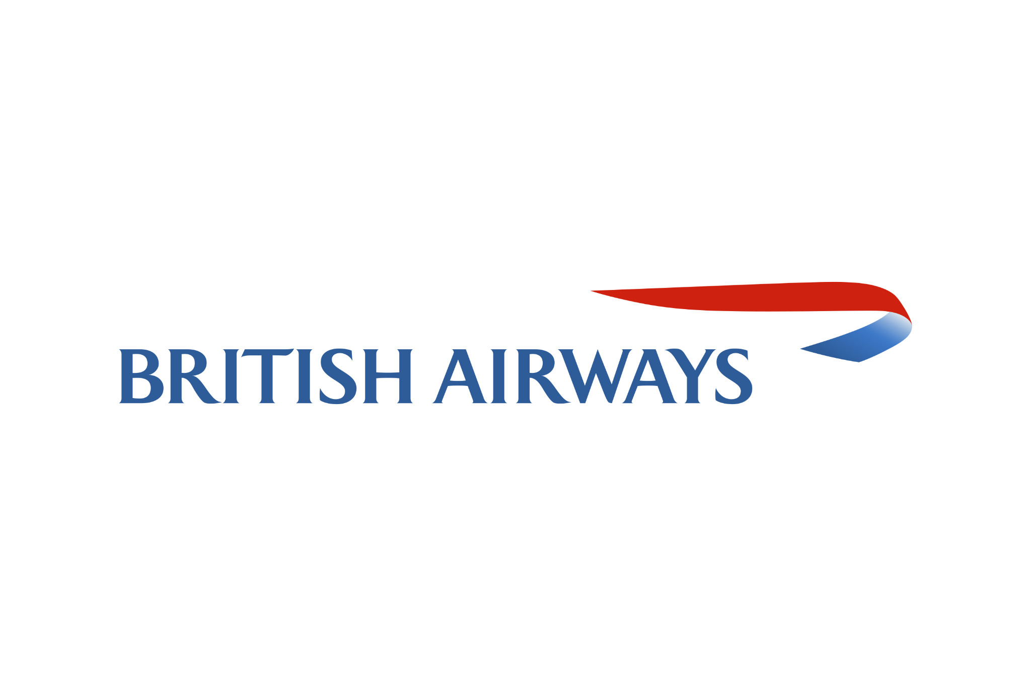
SKYTRAX AIRLINE REVIEW ANALYSIS
August 2023

Slide 2
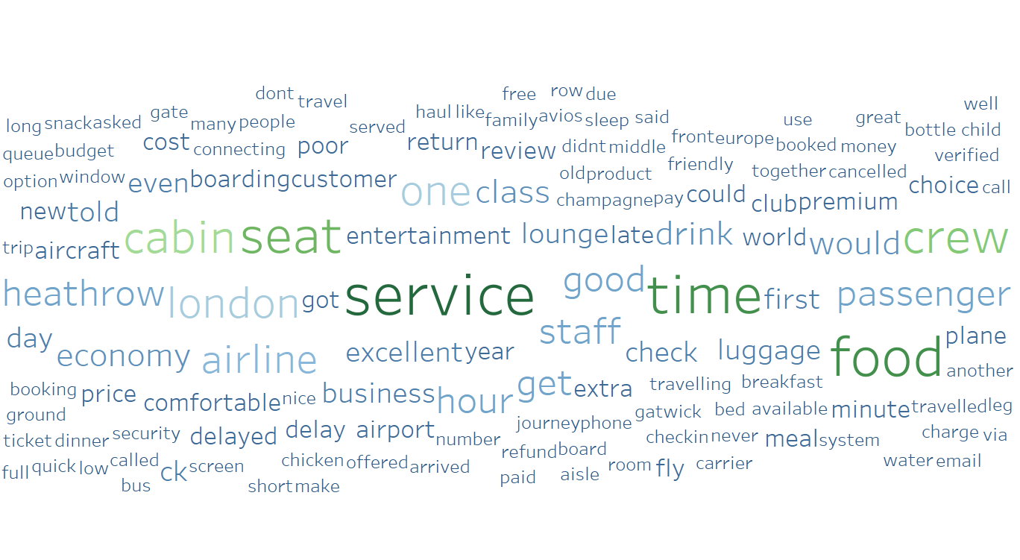
Data Overview
The data comprised of 3621 online reviews from Skytrax, an airline review and rating website.
The reviews were categorized into positive, negative, and neutral sentiments.
Methodology
Topic modelling, Sentiment analysis, Word cloud
Key takeaways
From the reviews 70.76% were positive, 28.61% negative and 0.63% neutral.
The word cloud shows that the key topics within the reviews include service, time, food, seat and crew.
The positive reviews emphasized on smooth operations, attentive staff, comfortable seating and quality lounges.
The negative reviews revolved around flight delays, customer service issues, uncomfortable seats and challenges with boarding and communication.
Proposed Solution
Focus on improving flight experience, seating comfort, service quality, and punctuality.

